Slide 1
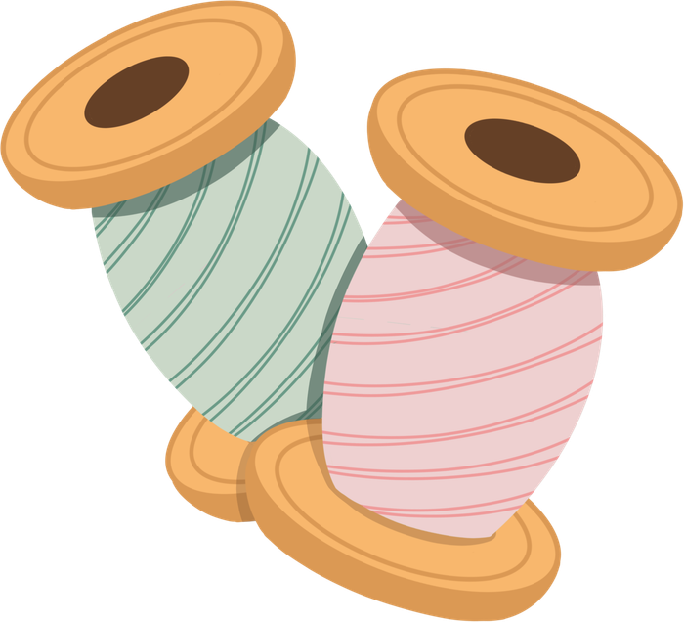

Successful
Sew
ng
Labs
Jessica Maker

Slide 2
Where are We at?
I am
Terrified
A little
nervous
Should
be fine
I got
this!
Notes:
Other polls: Never Sewed, Some Experience, Pretty Advanced.
Range on what will be taught:
Some will not teach sewing
5th-7th- Maybe just handsewing
8th-10th- Machine sew
11th-12th- More advanced skills

Slide 3
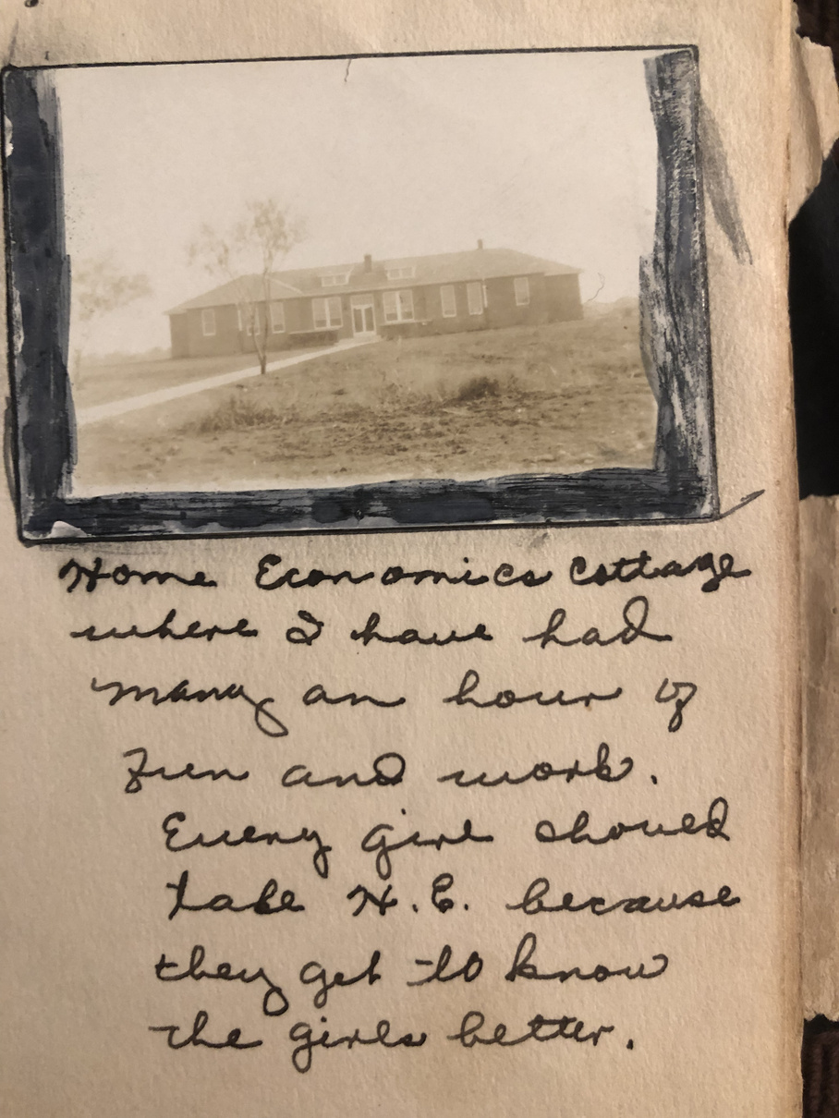
My Story
Notes:
My story with sewing started with my Grandma. She learned to sew in Home Ec in school. When I was growing up, she started sewing dance costumes for my studio to pay for my competitive dance. I started making My Size Barbie costumes with scraps on the floor. I took a home ec class in middle school and learned to sew a pillow. In college, we took classes with the fashion design students. I cried every single day. When I had my daughter, I wanted to try so I just started, as terrible as I was, I just needed to keep trying. I joined FB groups and watched a lot of videos and kept going. Eventually I started teaching fashion design and it was my FAVORITE. Now I dabble in side work. Picture is of my great grandma's scrap book.

Slide 4
Why Sewing?
Transferrable Skills
Motor skills
Problem solving
patience & perserverance
Following directions
Pattern Reading
Time Management
Organization
Quality Control
Tool Safety
Task Completion
Geometry, art, Technology

Slide 5
Why Sewing?
Careers
Alterations
Tailor
Designer
Textile Industry
Upholstery
Screenprinting
Embroidery
Pattern Designer
Fashion Merchandiser
Costume Designer
Sewing Machine Tech
Manufacturing
Notes:
These are all careers possible in Oklahoma today.
Designer- Not just apparel, but speciality as well such as costumes for sports.
Upholstery- Boat and Automotive
With Etsy and other online opportunities, pattern designing and handmade items are opportunities for people to work from home.
The film industry in Oklahoma is growing and growing. Costume designers are needed on sets.
Did you know, all military textiles have to be made in the United States?
The textile industry is in great need!

Slide 6
  Inventory
  Plan the workflow
  Establish procedures
Organization
  Inventory
  Plan work flow
  Establish Procedures
  Test Machines
Notes:
Start by assessing your inventory and what your needs are.
Plan your workflow- How many students will you have? Do you have enough machines? It's totally okay to share machines. If your machines don't have desginated space, will you be taking out and putting away each day? Think about electricity and where cords will be. Where will students cut and iron?
Establish procedures: You will hear your name 1,000,000 times! If you normally have bags, where will they go? How will students get your assistance? (Board Method) Where will supplies be? How will you handle scraps? How will you handle the fabric chaos? You will have early finishers, what will they do? Always spend 5 minutes cleaning up.
Assess your machine situation. Is everything in working order?

Slide 7
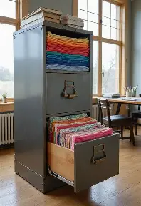
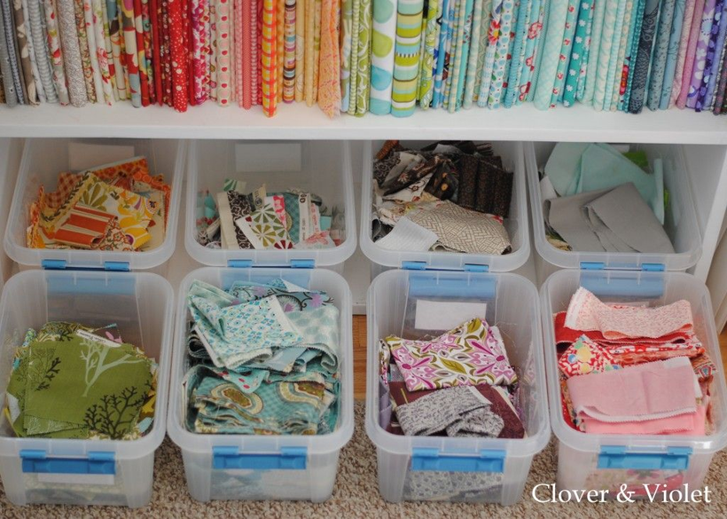
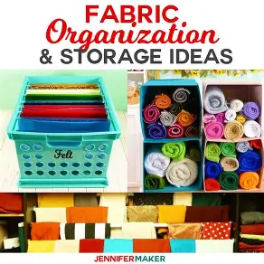
Organization
Procedures Video- Fabric Storage
Notes:
Managing the fabric chaos can be tough! The bin method and folded on a shelf are the most typical I see. File cabinets might be a good option. Fabric storage really depends on how often it will be utilized and what your storage capacity is.
You might find that you are walking into a "collection" with much more than you will ever need. Be on the cautious side whenever someone has a donation, don't be afraid to ask questions so you don't end up with more of a task than you want. Thread and fabric wears out.
Having clear procedures for scrap fabrics will help!

Slide 8
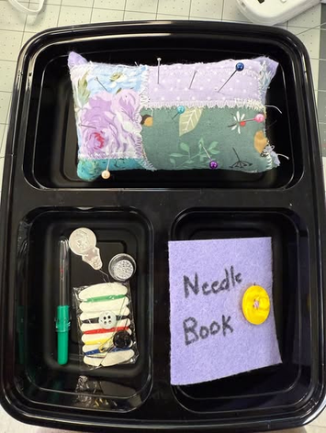
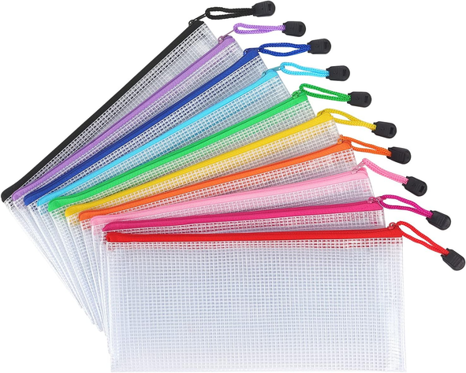
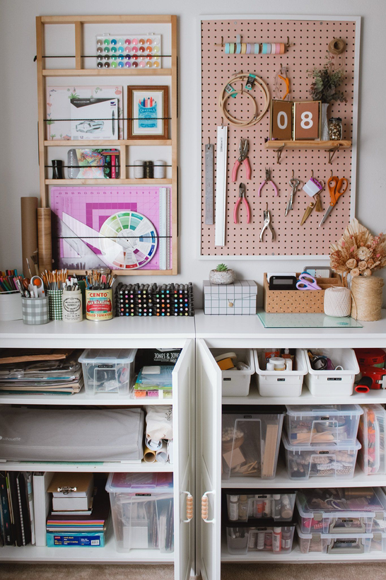
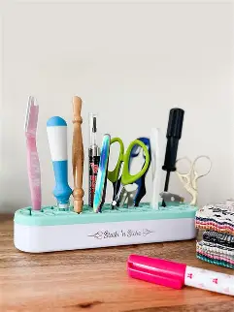
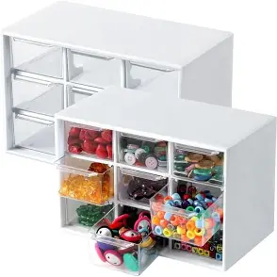
Organization
Notes:
Again lots of ways to store supplies.
How often will they be utilized?
Some supplies you might want to check off each day, maybe students have to check out and check in sewing needles each day. You could make a felt hanging cloth with numbers next to needles. Assign students a number and easily see which needles are missing.
I like to visualize supplies! I wanted to make sure all of my gingher sissors were put away each day hanging on my peg board.
Maybe you would prefer students having their own set of supplies. I liked this to-go container idea. Very cost efficient. I utilized these zipper bags a lot in the classroom. Students could keep unfinished projects in them.

Slide 9
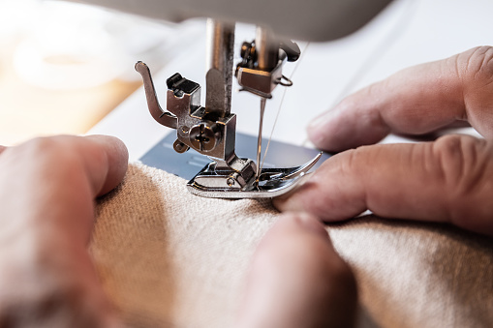
Safety
first
  100% on Safety tests
for every student, every year.
  Reinforce, reinforce, reinforce
  Practice what you preach
  Clear expectations
Notes:
Before starting any sewing, all students should pass their sewing safety tests with 100%. This should be repeated for all students every year. Save these test results because they are part of your program evaluation.
Safety needs to be reinforced, constantly. The most important thing they learn is safety!
Practice what you preach! They are looking to you to show the way. If your saying don't put pins in your mouth, don't do it!
What could go wrong?
Needle in finger
Needle in eye
If someone helps, machine is off or person get ups from the machine so there is no accidental pressing of the foot pedal.
Burns from iron
goofing around
If students were intentionally being unsafe, there sewing privileges were removed. This was part of my syllabus signed.

Slide 10
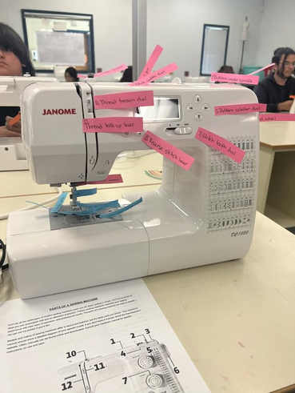
Instructional Strategies
  Lisence to Sew
  Games for review
    Kahoot, Gimkit, Blooket
    Bingo
    Headsup
  Human Sewing Machine
  Sewing Machine Label Relay
  Guess the Gadget
  Project Breakdown with examples
  So many ideas in FB Groups!
Teaching Sewing- Google Drive
Notes:
License to Sew is a fun way to teach sewing. Start by getting their safety permit (safety test), teach machine identification and how to thread the machine (User test), then let them practice on paper lines (drivers test).
I suggest for any project to have a breakdown of the project with examples visible with the step-by-step. Follow along videos are also a great resource that way they can rewind and go at their speed.
Utilize games to do review- any of the instructional game sites such as kahoot, gimkit, blooket. Or do class games such as bingo or heads up.

Slide 11
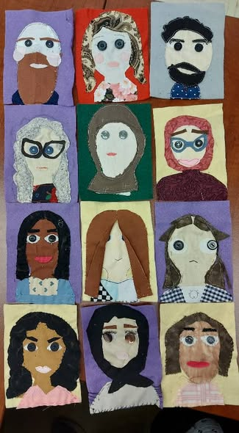
Hand Sewing IDeas
  Portrait of Self
  Tooth Fairy Pillow
  Hand warmer
  Thread Doodling
  Stitch Book
  Ornaments
  Fidgets
  bookmark

Slide 12
Beginner Project IDeas
  9 Square pillow
  Pajama Shorts
  Tote Bag
  Pillow Case “burrtio Method”
  Apron
  Make up Bag
Notes:
Before starting any sewing, all students should pass their sewing safety tests with 100%. This should be repeated for all students every year. Save these test results because they are part of your program evaluation.
Safety needs to be reinforced, constantly. The most important thing they learn is safety!
Practice what you preach! They are looking to you to show the way. If your saying don't put pins in your mouth, don't do it!
What could go wrong?
Needle in finger
Needle in eye
If someone helps, machine is off or person get ups from the machine so there is no accidental pressing of the foot pedal.
Burns from iron
goofing around
If students were intentionally being unsafe, there sewing privileges were removed. This was part of my syllabus signed.

Slide 13
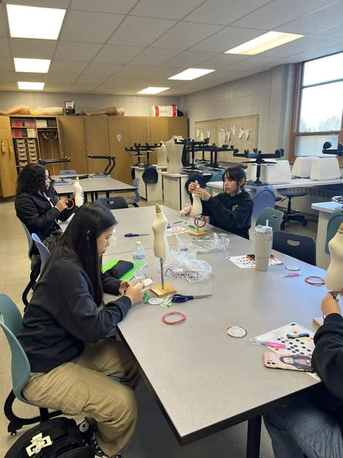
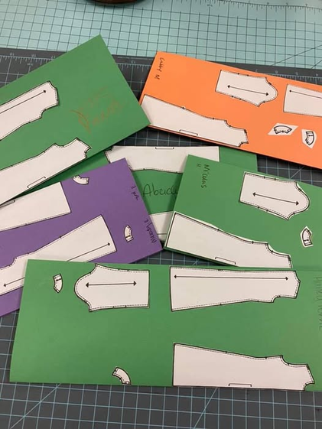
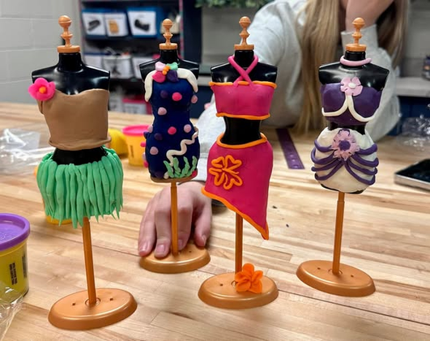
Work in Miniture

Slide 14
Getting Supplies
Textiles
  OKC Fabric Mart
  Hobby Lobby
  Michaels
  Walmart
  Amazon
  Mood Fabrics
Notions
  Wawak
  Amazon
  Mood Fabrics
  Okc Fabric mart
Equipment
  B Sew Inn
  World Weidner
  Bernina of OKC
  Bernina Sewing Center
  The Dress Shop
Kits
  Prarie Quilts
Notes:
Wawak is my favorite for notions! This is what professionals use.
Amazon can have great deals for bulk ordering of supplies. I've had luck with fabric, too. You just never know.
Prarie Quilt is great for precut projects kits.
I don't have any Southeast Ok suggestions, so sorry!

Slide 15
Free PDF Patterns
Freebies Archives - Patterns for Pirates
Freebies Archives ⋆ Made for Mermaids
CKC Patterns- Free Patterns
400+ Free Sewing Patterns | Mood Sewciety
25 Free Sewing Patterns For an Absolute Beginner

Slide 16
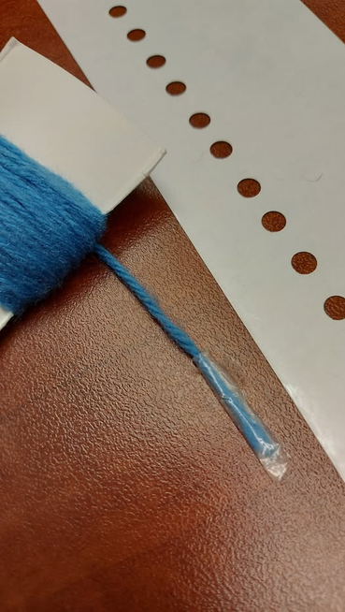
Inclusive Sewing
Website Resources
  Adaptive Sewing Equipment Guide
  Adaptive Sewing Patterns
Project Ideas
  Tshirt design with Fabric Markers
  Fabric Color sort
  Plastic Canvas Sewing
  Tie Blankets
Notes:
You will have students of all abilities in your classroom. Every student deserves a learning opportunity that fits their needs, challenges them, and excites them!
To fit the needs of students, sometimes you just need to get a little creative! What is the intended learning outcome? What are ways that can be done?
Textured tape and document camera for visual impairments
Tape a pencil under foot pedal, or machines with speed control
Shelby's story

Slide 17
Teaching Tips
  teaching THreading the machine really well !
  Limit thread colors- black, grey, white
  Three before Me
  Que on Board

Slide 18
Link Resources
My Book of Stitches
SewingMachineTroubleShootingDRingCards
Textiles Techniques Notebook
Printable Sewing Practice Sheets
Teaching Warp, Weft, Bias
Dawn Sommers Fashion Studio

Slide 19

Youtube Resources

