Slide 1
Long Term Care Workshop
September 22, 2026
Understanding Deeming
Stacey Marrazo, MS, BA Health Facility Surveyor III

Slide 2
What Is Deeming?
Deeming is an additional 16 hours of training taken by an aide to earn an additional certification.
Who can take Deeming?
An aide who already holds another active and verified certification that qualifies as a base certification.

Slide 3
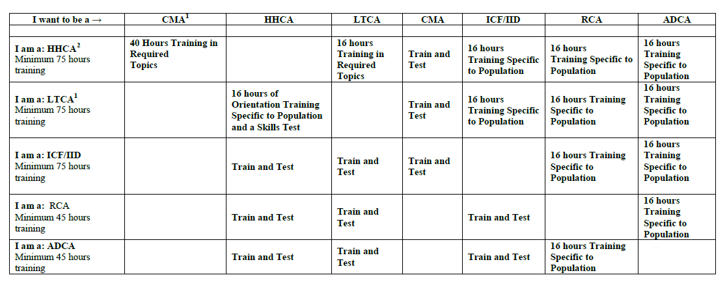
Deeming Table
Notes:
All HHA, RCA, & ADCA are currently deeming. 0 training programs.

Slide 4
Why do we offer HHA deeming if LTCA can work in HH?
Because CFR states that hospice aides MUST be certified in home health

Slide 5
What aide types can deem to HHA?
Only LTCA

Slide 6
How many of the deeming programs are there?
Notes:
Next slide

Slide 7
Deeming Programs in Oklahoma
Facility ID | Facility Name
Deem100 | Francis Tuttle Technology Center
Deem102 | Pioneer Technology Center
Deem103 | Northeast Technology Center <locked>
Deem104 | Kiamichi Technology Center
Deem107 | Red River Technology Center
Deem108 | Wes Watkins Technology Center
Deem109 | Moore Norman Technology Center –Flex
Deem112 | Guthrie Job Corps Center -Flex <locked>
Deem113 | Northeast Technology Center
Deem114 | Meridian Technology Center
Deem115 | Gordon Cooper Technology Center <locked>
Deem116 | Gordon Cooper Technology Center
Deem118 | Kiamichi Technology Center –Flex
Deem119 | Central Technology Center
Deem120 | Tulsa Technology Center <locked>
Deem121 | Autry Technology Center
Deem124 | Kiamichi Technology Center –flex
Deem125 | Kiamichi Technology Center
Deem126 | Tri County Technology Center <locked>
Deem127 | Eastern Oklahoma County Technology Center <locked>
Deem129 | Kiamichi Technology Center
Deem130 | Kiamichi Technology Center
Deem131 | Canadian Valley Technology Center -Hybrid Flex
Deem132 | Kiamichi Technology Center Flex
Deem133 | Southern Oklahoma Technology Center
Deem134 | Green Country Technology Center
Deem135 | Francis Tuttle Technology Center <locked>
Facility ID | Facility Name
Deem136 | Kiamichi Technology Center
Deem138 | Indian Capital Technology Center <locked>
Deem139 | Pontotoc Technology Center
Deem140 | Southwest Technology Center
Deem141 | MedNoc Training College
Deem142 | Metro Tech
Deem145 | Health and Safety Education Training Center
Deem146 | Kiamichi Technology Center
Deem147 | Chisholm Trail Technology Center
Deem148 | Canadian Valley Technology Center –Flex
Deem149 | Kiamichi Technology Center
Deem150 | High Plains Technology Center <locked>
Deem151 | Focused Training
Deem153 | Northeast Technology Center <locked>
Deem154 | MedNoc Training College –online
Deem155 | CNA Training Academy
Deem156 | Glory Nursing
Deem158 | Mid-Del Technology Center <locked>
Deem159 | Shadow Nursing –Flex
Deem160 | Family Healthcare Training –Online
Deem161 | Mid-America Technology Center
Deem162 | Shift Change Healthcare Academy
Deem163 | Family Healthcare Training III -Hybrid Flex <lock
Deem164 | Wings Health Care Training
Deem165 | Northeast Technology Center <locked>
Facility ID | Facility Name
Deem166 | Western Technology Center
Deem167 | EmpathyEd Healthcare Training –Hybrid
Deem168 | Indian Capital Technology Center
Deem169 | Northwest Technology Center
Deem170 | First Step Healthcare Training (Care Providers)
Deem171 | Cohesive Training Academy
Deem172 | High Plains Technology Center
Deem173 | Great Plains Technology Center <locked>
Deem174 | Western Technology Center
Deem175 | Western Technology Center
Deem176 | Northwest Technology Center
Deem177 | Western Technology Center
Deem178 | Indian Capital Technology Center <locked>
Deem179 | Rayanu Divine Education & Training School
Deem180 | Talking Leaves Job Corps -Flex <locked>
Deem181 | Family Healthcare Training II –Hybrid
Deem183 | Pathway Institute & Manor -Hybrid Flex
Deem184 | Indian Capital Technology Center <locked>
Deem185 | Moore Norman Technology Center <locked>
71 & 18 are locked
Notes:
How many?
Locked is a term meaning that the class can only be taken in conjunction with another NATCEP. It is not offered as a stand-alone program.

Slide 8

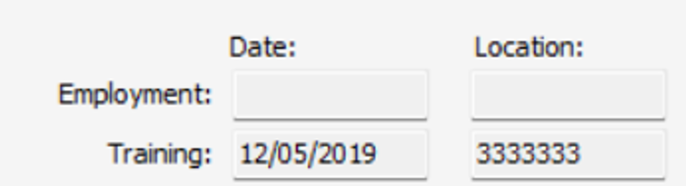


LTCA & HHA Certifications, Uploaded Same Day
LTCA Certification
HHA Certification
Notes:
The top row shows an LTCA & HHA added the same day, but the deeming was 3333333, which we can tell is not correct by the dates. The second row shows how is should read.

Slide 9
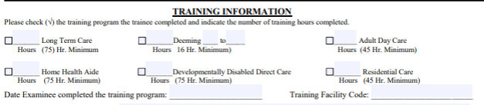
How to Complete Training Verification Form
All NATCEPs require a TVF to test.
X 75
X 16 LTC HHA
01/00/2027
3750000 / Deem000
Notes:
This is section 2 of the TVF, where deeming is indicated.
1. LTCA hours, if they only take the HHA portion, this will be blank
2. Deeming hours
3. Date of completion
4. BOTH program codes, if they only take the HHA, this will only have the Deem Code.

Slide 10

Notes:
If they have the LTCA to HHA Deeming form, there are 2 ways to handle it, 1. send them to testing to process it using 3333333 <OR> tell them to follow the instructions to mail in with the $15 fee.

Slide 11
Why are programs not uploading the HHA Deemed certifications?
Most are using 3333333
This is ONLY for outside deeming forms!
Notes:
If you have someone with a testing letter from NAR, this is when you would use 3333333.

Slide 12
If you do not know what your deem code is, email to ask.
If you do not have a deem code, complete a NOC to request a code and include what curriculum you will be using for the class.
Email all requests to NAR@health.ok.gov

Slide 13
Additional Handouts
Training Verification Forms
CMA
CMA-GM or IA
CMA-RG (or R, NG)
Notes:
CMA has attestation on it
CMA-GM or IA –if the do not take the written test or if they fail it, they can still mail the form in with $10 and get the GM added. NEVER EVER uploaded!
CMA-RG –you can note whether R/NG/RG on program name line. PLEASE fill in the correct number of hours.

Slide 14
Questions??
Stacey Marrazo, MS, BA
Health Facility Surveyor III
Nurse Aide & Home Care Administrator Registry Oklahoma State Department of Health
Main: 405-426-8150 | Fax: 405-900-7572

